Slide 1

Tim Vermande
Notes:
Tim Vermande

Slide 2

Notes:
Are you, to use a phrase, “as blind as a bat” … (photo: bat flying in darkness, Oren Peles, http://en.wikipedia.org/wiki/File:PikiWiki_Israel_11327_Wildlife_and_Plants_of_Israel-Bat-003.jpg, CC-A)

Slide 3
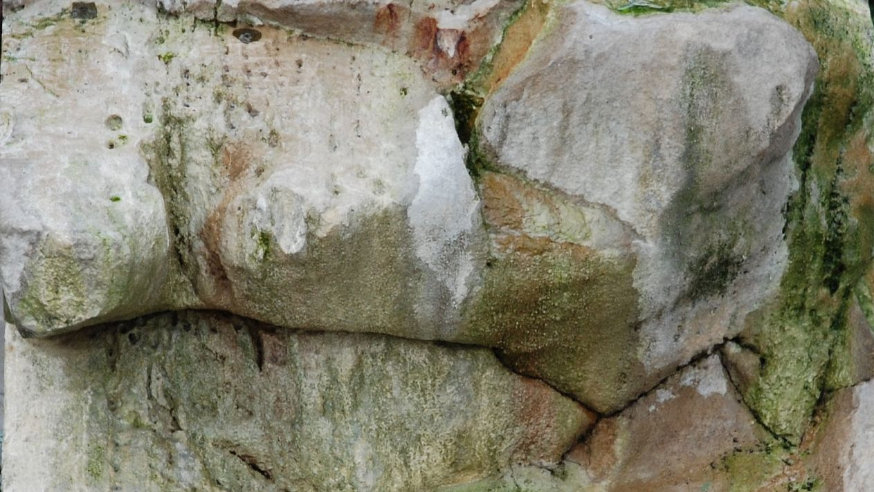
Notes:
… or perhaps, as deaf as a rock? (photo: rocks, Tim Vermande)

Slide 4
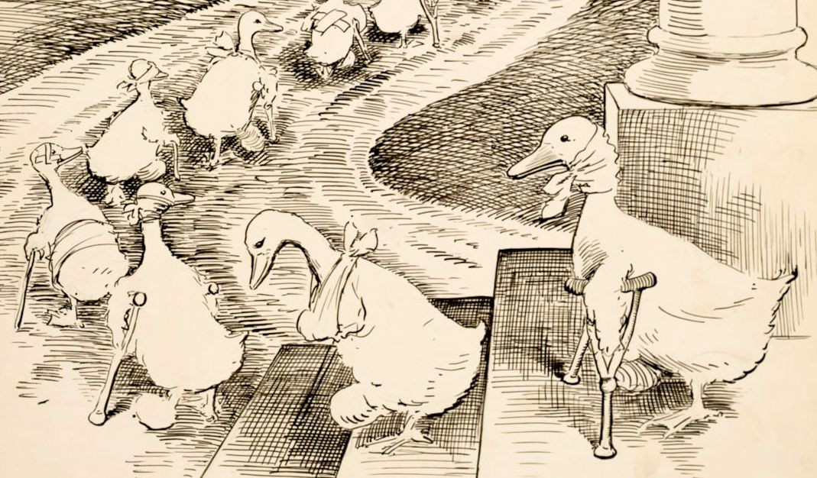
Notes:
… or full of lame excuses? (cartoon drawing: a series of ducks on crutches or splints, Clifford Berryman, 1915, http://www.archives.gov/exhibits/running-for-office/slurp-file.php?fileref=52, PD)

Slide 5

Notes:
The way we use disability metaphors in language is an ongoing point of concern.
At the Disability Ministries Committee, discussion about the name of our newsletter reflected this. We ended up with “The Voice” after some discussion. In the course of settling on this choice, we concluded that we could always offend someone, but after looking at disability etiquette we also realized that such things as “see you later” or “walk with me” are allowable (and, thinking of inclusion—focusing on being together in a social setting, more than the specific motion—are to be encouraged). (Illustration: header of The Voice).

Slide 6

Notes:
The answer about inclusion of everyone is a good one. And if we’d listen to Jesus we would know that our initial perceptions of senses aren’t always right! The rocks sing, and science tells us that bats see better than humans. (Photo: water rushing over rocks, Tim Vermande).

Slide 7
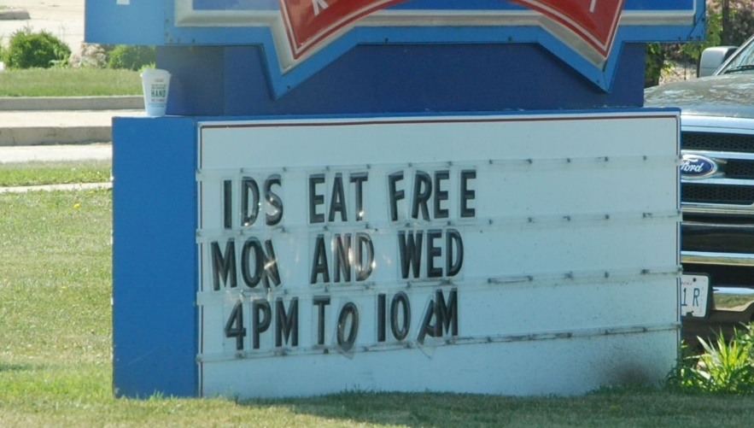
Notes:
As we have just found out, language is a powerful sensory impressor.
And as we have also found, language is also susceptible to mistakes, misunderstanding and misinterpretation.
These factors make language a powerful tool. It is one of the distinguishing marks of humans, or if you will, perhaps a component of the imago Dei.
(Photo: restaurant sign reading “ids eat free”, Tim Vermande).

Slide 8
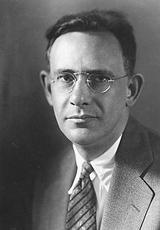
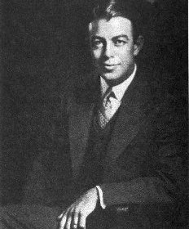
Sapir – Whorf (1929)
Notes:
In linguistic anthropology, we have a much-discussed theory, one that we keep returning to, formulated by Edward Sapir and his student Benjamin Whorf that seeks to explain some of this power of language, by showing how it shapes our views of the world. This is a wide-ranging theory, but we will focus on a couple of aspects.
(Edward Sapir, Florence Hendershot, Fair Use) (Benjamin Whorf, Yale University Library, Fair Use)

Slide 9
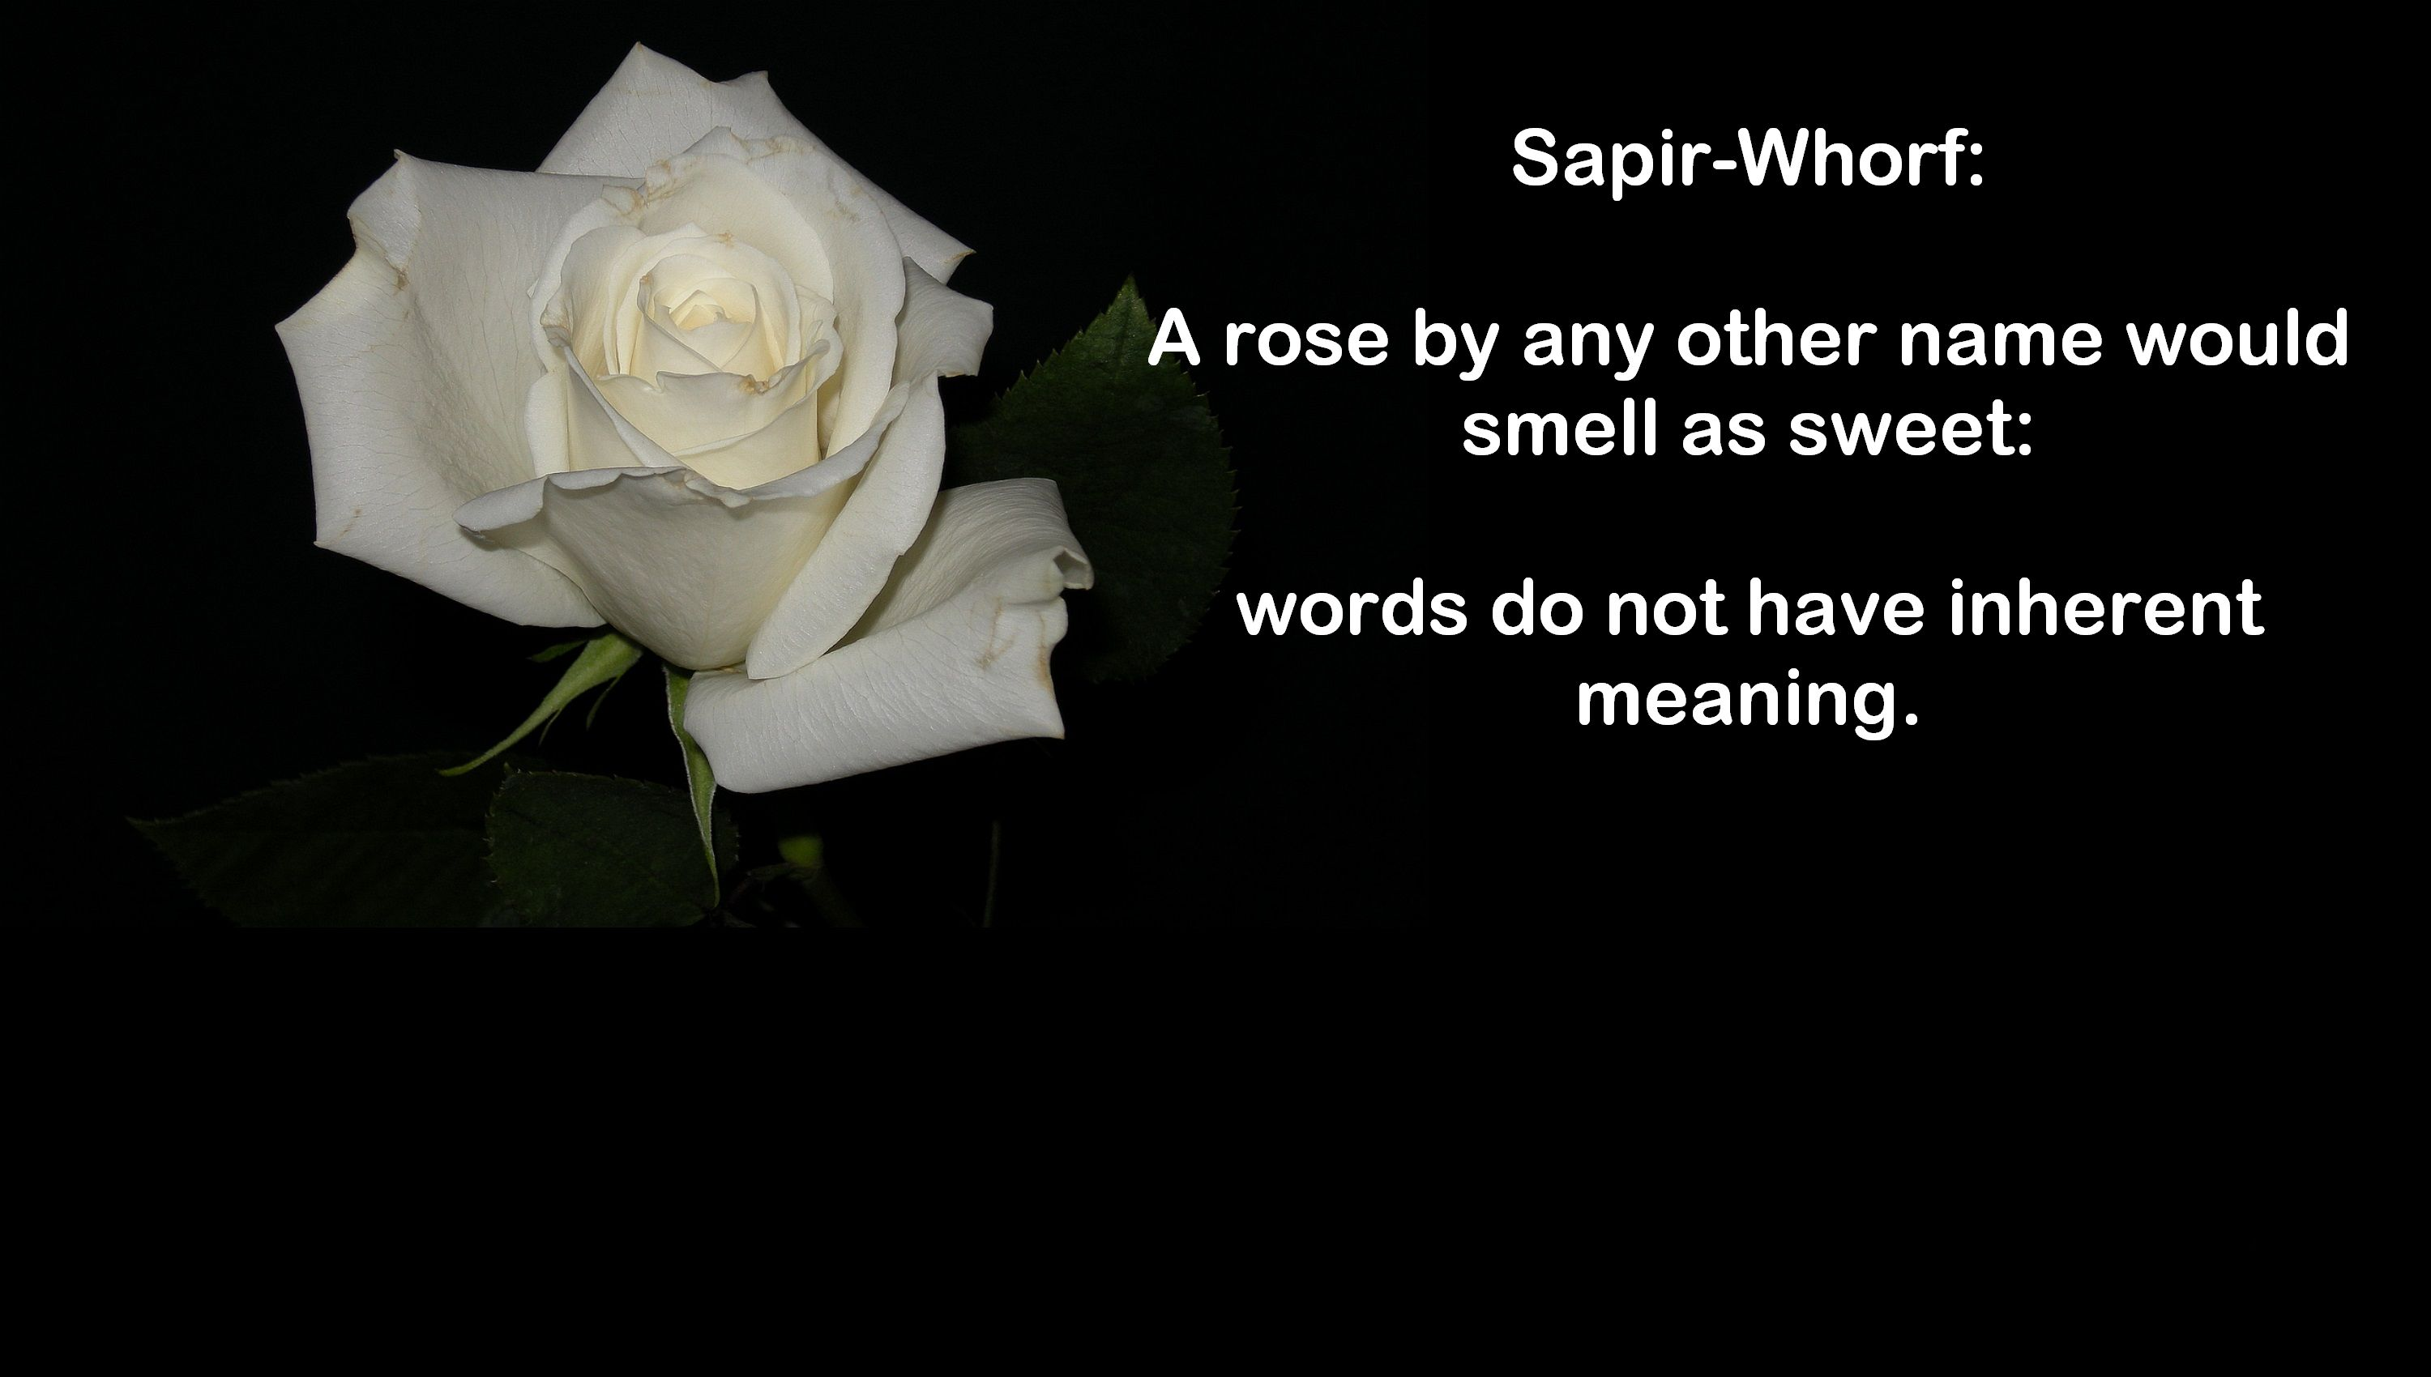
Notes:
The theory first tells us that language does not have inherent meaning, but its functions are determined by culture. Therefore meaning attached to a language is not fixed across cultures. (Photo: rose in a corner, text “A rose by any other name would smell as sweet: words do not have inherent meaning. “)

Slide 10
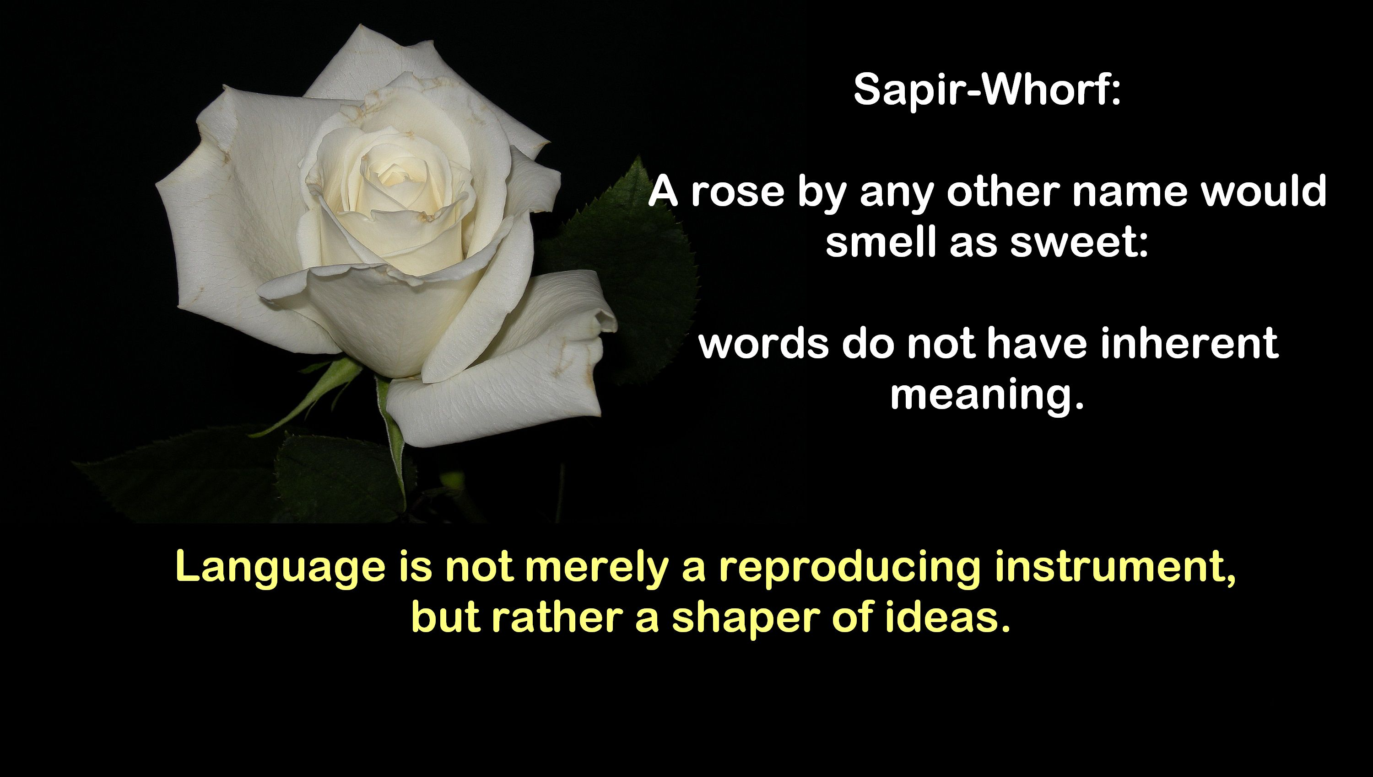
Notes:
Moreover, language and how we use it shapes our views of the world. A simple example is that some languages do not have a future or past tense. Some languages assign gender to objects (e.g., a key is masculine in one and feminine in another, and body parts, even of women, are masculine in some). (Similar photo, added to bottom is the line “language is not merely a reproducing instrument, but rather a shaper of ideas.”)

Slide 11

Sapir – Whorf
Language use creates “socio-linguistic rules.”
What is this stuff?
Notes:
Because the meaning in a language is cultural, there are rules that one learns about how to apply it.
What is the stuff in the picture?

Slide 12
Sapir – Whorf
Language use creates “socio-linguistic rules.”
Language shapes different views of the world through connotation: example of “lawn” or “pop.”
Notes:
The rule which concerns us most here is connotation, or what a word means in a given setting.
The word “lawn” carries different meaning to people who have to mow one, compared to those who don’t.
“Pop” is also an example of dialect, which is a regional variation in a language.

Slide 13
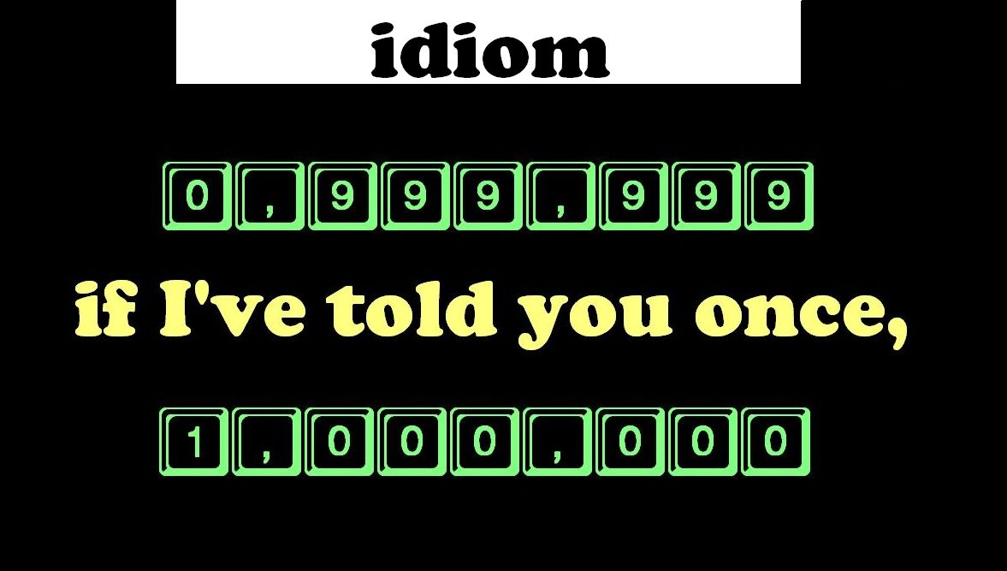
Notes:
Another socio-linguistic rule, determined also by connotation, is the use of idiom.
A frequent idiom: “If I’ve told you once, I’ve told you a million times!”
(Graphic of a counter clicking from 999,999 to 1,000,000 with “if I’ve told you once” in between the numbers).

Slide 14
Idioms
“If I’ve told you once, I’ve told you a million times!”
Disability etiquette tells us it’s ok to say things like “see you later.”
Notes:
Idiom allow us to say things that aren’t literally true.

Slide 15
Idioms
“If I’ve told you once, I’ve told you a million times!”
Disability etiquette tells us it’s ok to say things like “see you later.”
What do we really mean? “I’ve repeated myself a lot,” and “I hope to be with you again.”
Notes:
The words are a shorthand for something else. But…

Slide 16

Notes:
There’s a line between idiom and offense.
Recent article: https://theconversation.com/forever-crooked-how-everyday-language-reflects-negative-attitudes-about-the-physically-disabled-38881

Slide 17

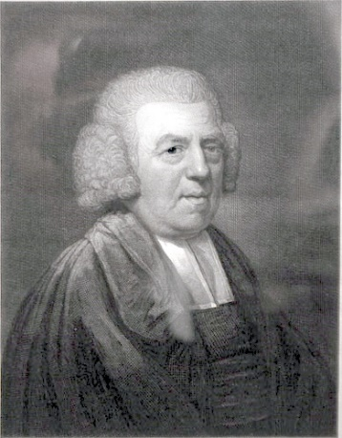
Notes:
To many people, John Newton crossed that line in the hymn “Amazing Grace,” where spiritual unawareness is compared to a disability. This line has generated a lot of writing, and sparked my own interest.
(Newton painting: Joseph Collyer the Younger, 1807, http://en.wikipedia.org/wiki/File:Newton_j.jpg, PD)
(Southern Harmony, 1847, http://en.wikipedia.org/wiki/File:New_Britain_Southern_Harmony_Amazing_Grace.jpg, PD)

Slide 18
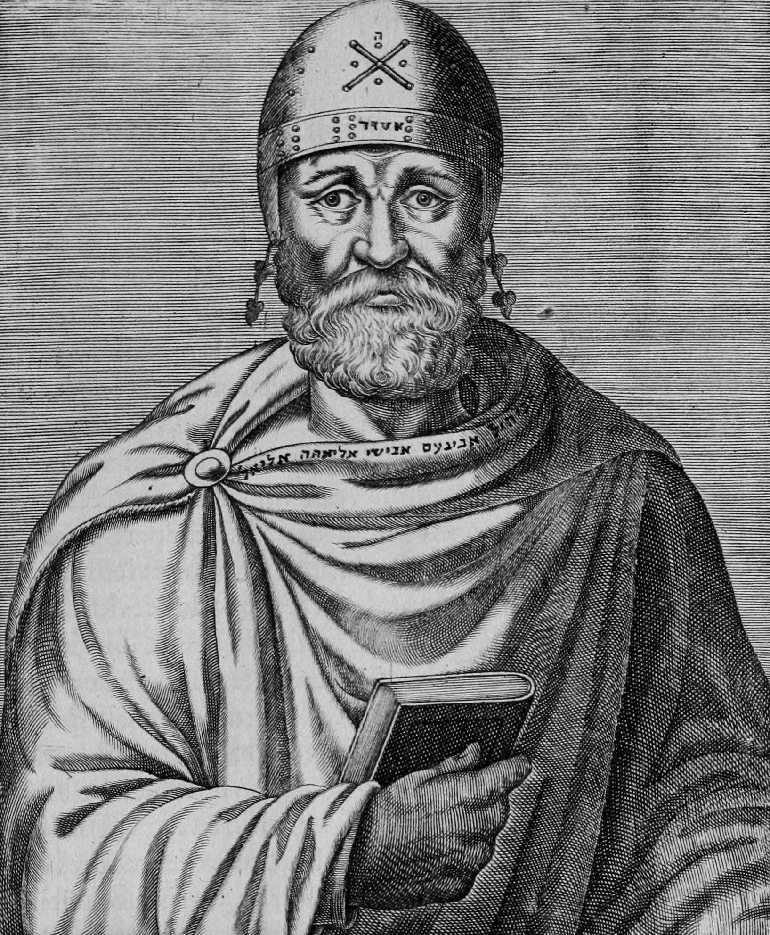
Philo
c. 25 BCE –
c. 50 CE
Notes:
So I began to think about whether it was a scriptural reference, or what else we might use.
I started with a look at some contemporaries of Jesus and the early church. (Philo: Andre Thevet, 1584, https://archive.org/details/lesvraispourtrai01thevPD)

Slide 19
.… as if suddenly awakening from a deep slumber and opening the eye of the soul, and beginning to perceive a pure ray of light instead of profound darkness, followed the light ….
Notes:
In De Abrahamo 15, Philo writes of Abraham's spiritual awakening as διοίξας τὸ τῆς ψυχῆς ομμα (awakening the soul as if from sleep).
But he also writes of opening the soul’s eye, and thus, I think, opens the door to speaking of blindness.

Slide 20
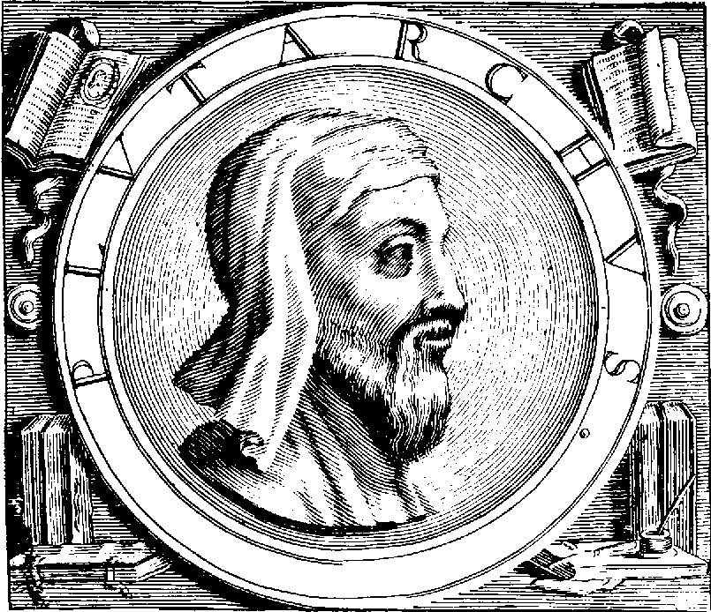
Plutarch
c. 46 –
c. 127 C.E.
Notes:
Plutarch: a little later, somewhat overlapping the life of Paul.
(Line drawing of Plutarch, anon from Amyot’s Parallel Lives, 1565, http://en.wikipedia.org/wiki/File:Plutarch.gif, PD)

Slide 21
And now, as if they were dreaming of God the most glorious dream, let us stir up and exhort them to ascend higher ….
Notes:
In De E Apud Delphos 21, Plutarch refers to those who are spiritually unaware as having καλλίστῳ τῶν ἑνυπνών (beautiful, fanciful dreams, i.e., being asleep). The context is seeking to know God better, as far as a human can do this.

Slide 22
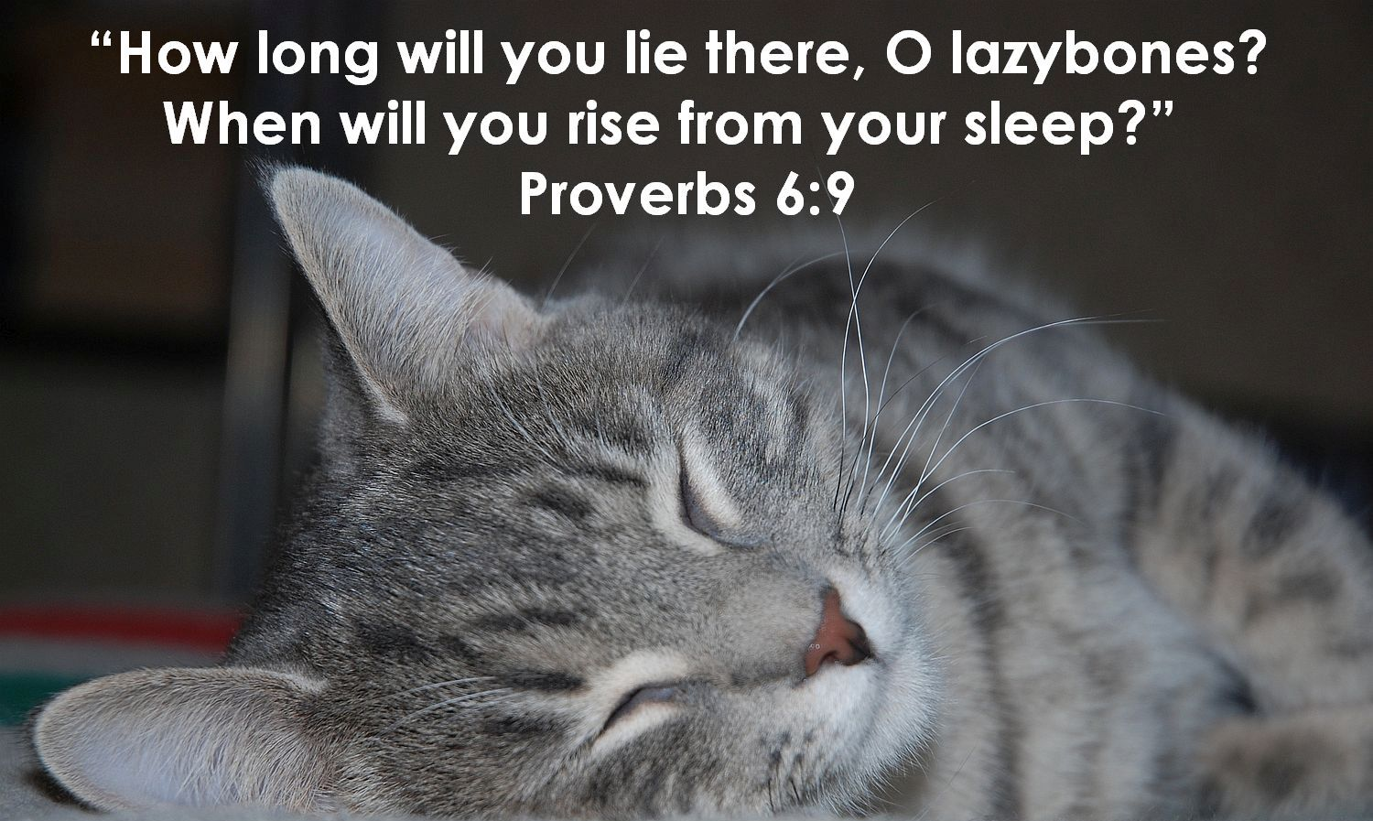
Notes:
The metaphor of sleep does have a Biblical basis. (Photo: sleeping cat, a grey tabby, with quotation from Proverbs 6:9: “How long will you lie there, O lazybones? When will you rise from your sleep?”)

Slide 23
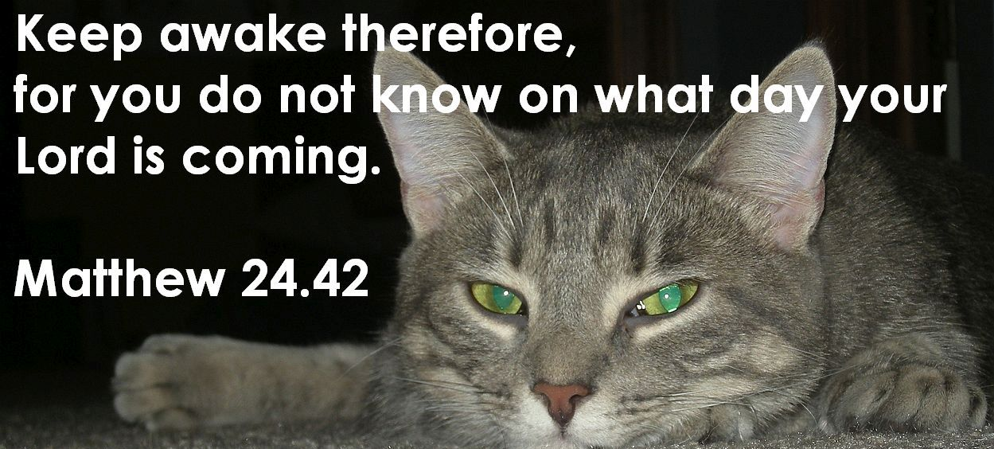
Notes:
Or, again-- (photo: same grey tabby, awake and staring at camera, text is Matthew 24.42, “Keep awake therefore, for you do not know on what day your Lord is coming.”)

Slide 24
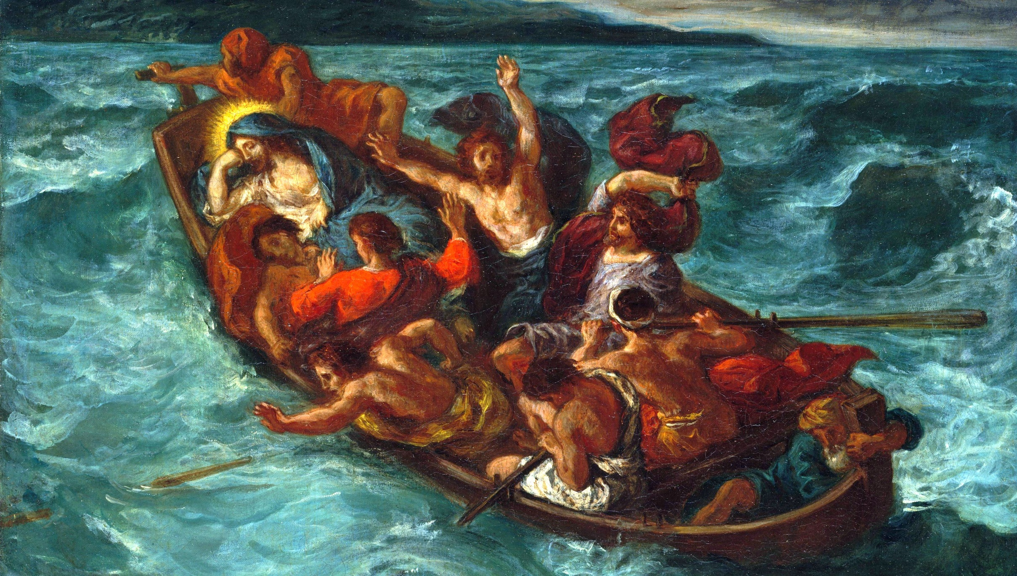
Notes:
Being able to sleep is also a sign of faith, so we are again led to a place where we must consider context as we interpret writings. “But (Jesus) was in the stern, asleep on the cushion; and they woke him up…” Mk 4:38 , Matt 8.23-27
(Delacroix painting of Jesus sleeping in the boat: https://en.wikipedia.org/wiki/File:Eug%C3%A8ne_Delacroix_-_Christ_Endormi_pendant_la_Temp%C3%AAte.jpg).

Slide 25
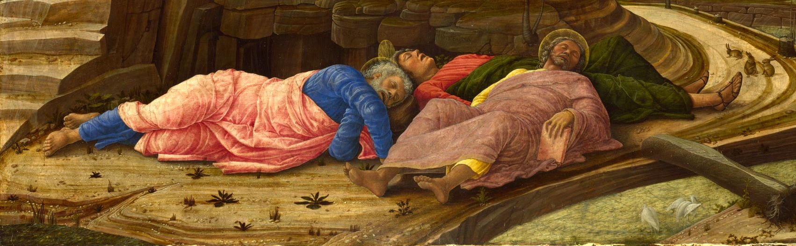
could you not stay awake with me one hour?
Matthew 26.40
Let us not fall asleep, but let us keep awake…
1 Thessalonians 5.6-8
Notes:
Jesus chided the disciples who fell asleep during an hour of prayer (Matthew 26.40).
Paul also admonishes us to stay awake (1 Thessalonians 5.6-8)
Photo: Andrea Mantegna, The Agony in the Garden (part), 1460; https://en.wikipedia.org/wiki/Agony_in_the_Garden#/media/File:Agony_in_the_Garden.jpg

Slide 26
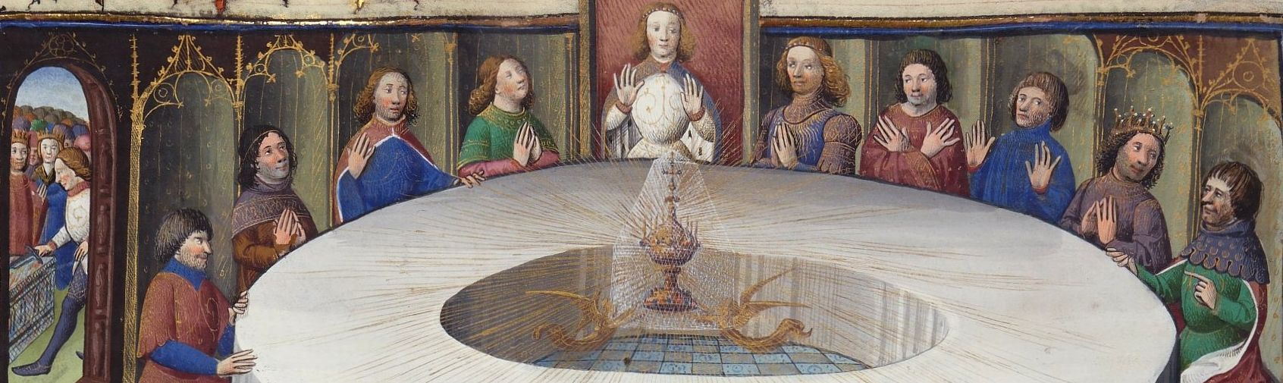
"but just as you may see a man wander at times from his path when he falls asleep, and retrace his steps at once on waking, so also it is with the sinner who falls asleep in mortal sin . . . ."
Notes:
We also find this metaphor in medieval literature.
The Quest of the Holy Grail (P. M. Matarasso, translator, New York: Penguin Books, 1969), 88.
Photo: Maître des cleres femmes, 1405-1407, https://commons.wikimedia.org/wiki/File:Holy-grail-round-table-bnf-ms-120-f524v-14th-detail.jpg

Slide 27

Notes:
So when the sun went down last night, how many of you slept?

Slide 28
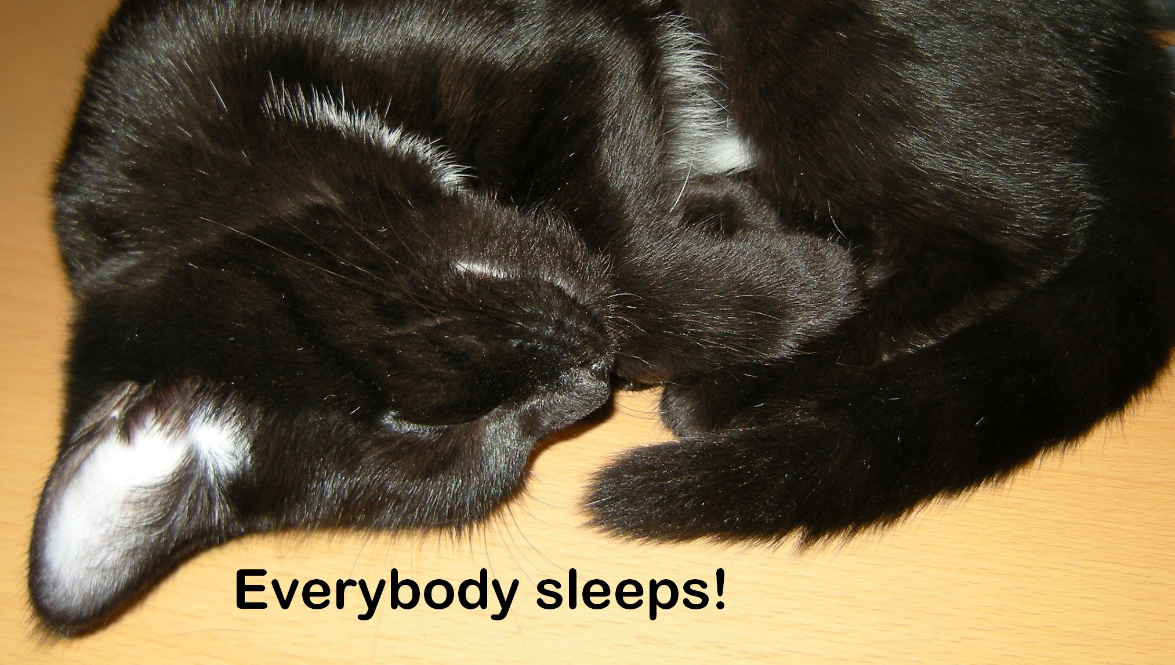
Notes:
I hope this isn’t a surprise, but everybody sleeps. Sleeping covers a variety of experience, and it’s also universal to humans. Languages have different words and connotations for various levels, but we all do it. (Photo: black cat curled in a ball, sleeping; text: everybody sleeps!).

Slide 29
The best metaphors use
“primal terms accessible to every human soul.”
Madeleine Marshall
Notes:
Why does this matter? Madeleine Marshall states that the best metaphors are those such as Newton's that use "primal terms accessible to every human soul" (Common Hymnsense, Chicago: GIA, 1995, p. 82).
But is that true here? The experience of blindness is not a part of the life of many people, and occasional bouts of walking in the dark are hardly a true experience of blindness (think about the critiques of disability simulations).
Sleep is far more primal and universal experience.

Slide 30
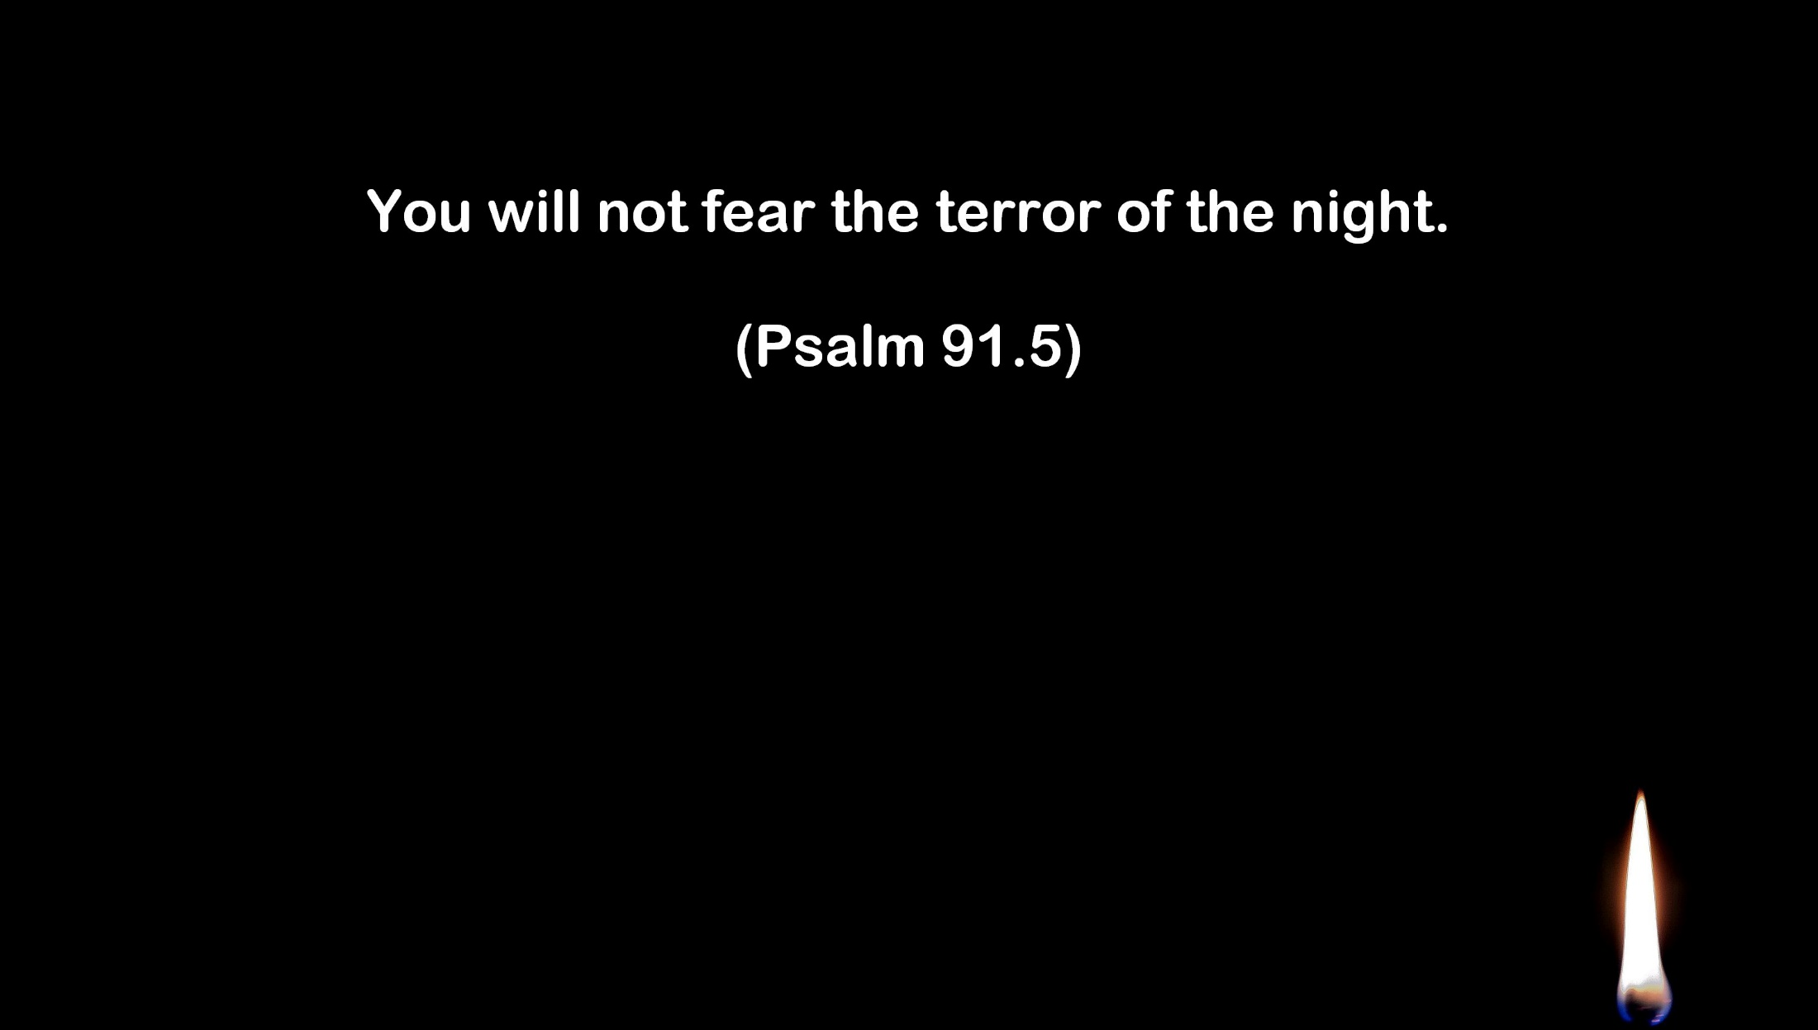
Notes:
Are we trying to avoid talking about fears? This is often suggested as a reason for the stigma that goes with disability.
Fear of sleep (hypnophobia or somniphobia) can be a serious condition. We can (we think) limit blindness, but we must all deal with what the Psalmist calls “the terror of the night”. We do not have any control over the occurence of disability, but language can control its effect, by limiting it to conditions that most of us won’t experience. Blindness is therefore acceptable in an ableist reading.
(Photo: Psalm 91.5 against black background, small candle in corner).

Slide 31

Notes:
And this brings us to John Calvin. He wrote that poor eyesight was not like other disabilities (which he was disparaging toward) because technology could correct it [Inst., 1.6.1 (1: 70); 1.14.1 (1: 160-161)]. This emerging attitude reminds us that while the Reformation was a theological shift toward recovery of justification by faith, it also inadvertently removed the mystery of the spirit from daily experience (what is the Eucharist post-Reformation?). The body is no longer part of a divinely-ordained natural cycle, it becomes an object of exploitation along with the rest of the world.
(https://upload.wikimedia.org/wikipedia/commons/7/7b/Calvin_1562.jpg)
Notes on this point: There are many studies in social-scientific literature which indicate that this is a typical pattern of distinction. People are far more likely to accept disabilities that are thought to be from a natural process or a non-preventable accident than those whose cause is mysterious. The studies also indicate greater tendency to accept “mysterious” disabilities when an all-controlling God is thought to be behind the operation of the universe. Although a fuller investigation is beyond the scope of this paper, Calvin’s psychological profile seems to fit this style of coping perfectly. R. J. Bulman and C. B. Wortman, “Attributions of blame and coping in the real world” Journal of Personality and Social Psychology 35 (1977): 351-363; Kenneth Pargament, “God Help Me: Toward a theoretical framework of coping for the psychology of religion” in Monty Lynn and David Moberg, eds, Research in the Social Scientific Study of Religion, Volume 2 (Greenwich: JAI, 1990), 202-207; Kenneth Pargament, Joseph Kennell, William Hathaway, Nancy Grevengoed, Jon Newman, Wendy Jones, “Religion and the Problem-Solving Process: Three Styles of Coping” Journal for the Scientific Study of Religion 27 (1988) 90-91; H. J. M. Eric Vossen, translated by S. Ralston, “Images of God and Coping with Suffering: the psychological and theological dynamics of the coping process,” Journal of Empirical Theology 6 (1993): 24-25.

Slide 32

Notes:
The effects of Calvin’s ideas on the wider social scene have long been debated. Perhaps The Protestant Ethic and the Spirit of Capitalism has fallen from favor, but the increasing interest in “normal,” reflected in such things as the adoption of standard time, the regimentation of industrial life, and the rise of a consumerist society all contributed to conformity of a standard of perceived perfection, to be distanced from the mysterious world of disability and an inscrutable God, and here, it seems to me, is at least one of the seeds.
At the surface, Plutarch and Philo demonstrate that not being spiritually alert does not need to be symbolized in terms of physical disability, nor need one correlate physical disability with a state of sinfulness. On another level, Plutarch and Philo exhibit a very different conception of spiritual awareness and symbolism than does Newton. It seems to me that the ancient Greeks, and early and medieval Christians used bodily images that fit more with the shared, natural cycle of everyday life.
(Photo: a visual koan, if you will: the rose in the upper left corner and the candle in the lower right).

Slide 33
Marjorie Procter-Smith says patriarchy is such an overarching part of the world that we view nearly everything in patriarchal terms. Therefore we must move beyond explicit balance to "emancipatory language" that challenges assumptions.
As the quote from Marshall shows, the same condition exists with bodily images.
What is the possibility of creating truly emancipatory bodily images?
(Marjorie Procter-Smith, In Her Own Rite: Constructing Feminist Liturgical Tradition, Nashville: Abingdon Press, 1990, 14-15, 64-66).
Notes:
A final challenge question.

Slide 34


